Slide 1

EARLOBE-BASED WEARABLE
FOR EARLY DETECTION OF SEPSIS-RELATED VITAL
SIGNS
ABNORMALITIES IN
BEDRIDDEN PATIENTS
A D U DEWMINI
D/ENG/23/0160/BM

Slide 2

CONTENT
Problem Identification
Aim
Objectives
Market survey
Components
system Design
Circuit Diagram
Solid work design
PCB design
Stimulation and results
Problems encountered
Cost estimation

Slide 3

PROBLEM IDENTIFICATION
Delayed Detection of Sepsis in Bed Patients
Lack of Continuous Monitoring
Uncomfortable and Inconvenient Monitoring Methods
Need for a Non-Intrusive and Comfortable Solution
Risk of Caregiver Dependence
Affordable and Accessible Health Monitoring

Slide 4

AIM
To design and develop a compact, non-invasive earlobe-mounted medical device that continuously monitors heart rate, blood oxygen saturation (SpO₂), and body temperature using integrated sensors, to detect early physiological signs associated with sepsis. The system incorporates a color-coded display and alarm mechanism to provide timely alerts for abnormal vital signs, enhancing early intervention and patient safety in home-care settings for bedridden individuals..

Slide 5
OBJECTIVES
Device Design and Sensor Integration
Real-Time Alert and Monitoring System
Wireless Communication and Data Transmission
To design and develop a compact, non-invasive earlobe-mounted device that continuously monitors heart rate, SpO₂, and body temperature using integrated sensors..
To implement a real-time alert system with color-coded visual indicators and audible alarms to notify caregivers of abnormal vital signs associated with early signs of sepsis.
To ensure the device is lightweight, comfortable for continuous wear, and operates efficiently with long battery life for reliable monitoring.

Slide 6

Target Group
Patients at increased risk of developing sepsis, those in home-care settings
Bedridden patients requiring continuous vital monitoring
Home-care patients with limited access to clinical observation
Elderly individuals more vulnerable to sepsis-related complications
Post-operative patients during recovery at home
Chronically ill or immunocompromised individuals at risk of infection
Patients with limited mobility or neurological impairments, where early signs of sepsis may go unnoticed

Slide 7
MARKET SURVEY
AVAILABLE PRODUCTS
Existing Devices for Early Sepsis Detection:
IntelliSep Sepsis Test (Cytovale) – 8 min detection using immune response analysis.
Sepsis aiMarker™ (Biocogniv) – AI-based prediction up to 72 hours in advance.
KATE AI Sepsis (Mednition) – 118% improved early detection in emergency triage.
Patient Status Engine (Isansys Lifecare) – Wearable smart patch for continuous monitoring.

Slide 8
MARKET SURVEY
AVAILABILITY OF PATENT RIGHTS
Multiple patents exist for biomarker kits, AI-based models, and wearable biosensors.
Patent Gaps- Opportunities for home-based monitoring, AI integration, and non-invasive diagnostics.
Freedom to Operate (FTO) Analysis required to ensure no patent infringement.

Slide 9
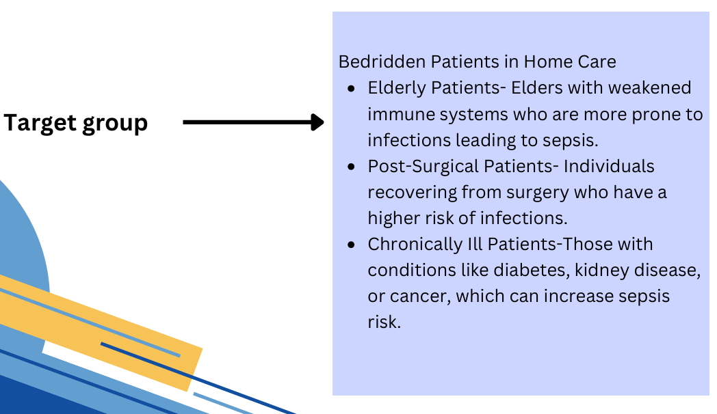

Slide 10
MARKET SURVEY
VALUE ADDITION FOR THE DEVICE
Affordable Home Monitoring-Unlike hospital-based systems, your device allows continuous sepsis monitoring at home.
Wearable & Adjustable Fit-Velcro strap for comfort ensures a secure and customizable fit for different patients.
Real-Time Alerts- improves detection accuracy while reducing false alarms.
User-Friendly Design- Plug-and-play operation, easy-to-read interface, and smartphone connectivity for caregivers.
Non-Invasive Alternative-Unlike blood-based biomarker tests, your device detects sepsis risk using real-time physiological monitoring.

Slide 11
COMPONENTS
ESP32-Processes sensor data, manages alerts
MAX30102 Pulse Oximeter Sensor- Heart rate₂ and oxygen saturation
MLX90614 Infrared Temperature Sensor-measure-Non-contact body temperature
LCD Display
Mini Buzzer (SP001)
LED - for visual display
3.7V Li-ion Rechargeable Battery
Resistors & Capacitors

Slide 12
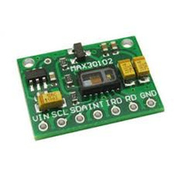
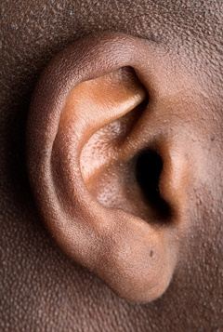
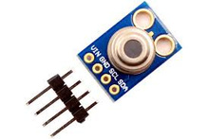
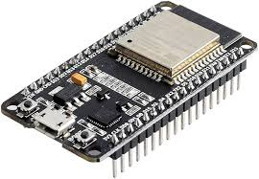
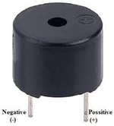
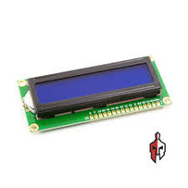
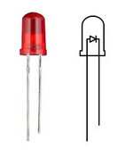
ear
SYSTEM DESIGN
Earlobe Sensor Unit
MAX30102
Pulse oximeter sensor
MLX90614
Tempreature sensor
ESP32
Data transmission
Green LED: Indicates normal/healthy readings.
SpO₂: 94%-100%
Heart rate: 60-90 bpm
Body temperature: 36°C-37.5°C
Yellow LED: Signals a warning that one or more vitals are approaching abnormal ranges.
SpO₂: 90%-94%
Body temperature: 37.6°C-38°C
Red LED: Signals a critical condition where intervention is needed immediately. For example:
SpO₂: <90%
Heart rate > 90 bpm
Body temperature: >38°C or <36°C
There is a audible alert from buzzer when red LED is on
LCD Display
LED Indicater
Buzzer
Data Display and Alert

Slide 13
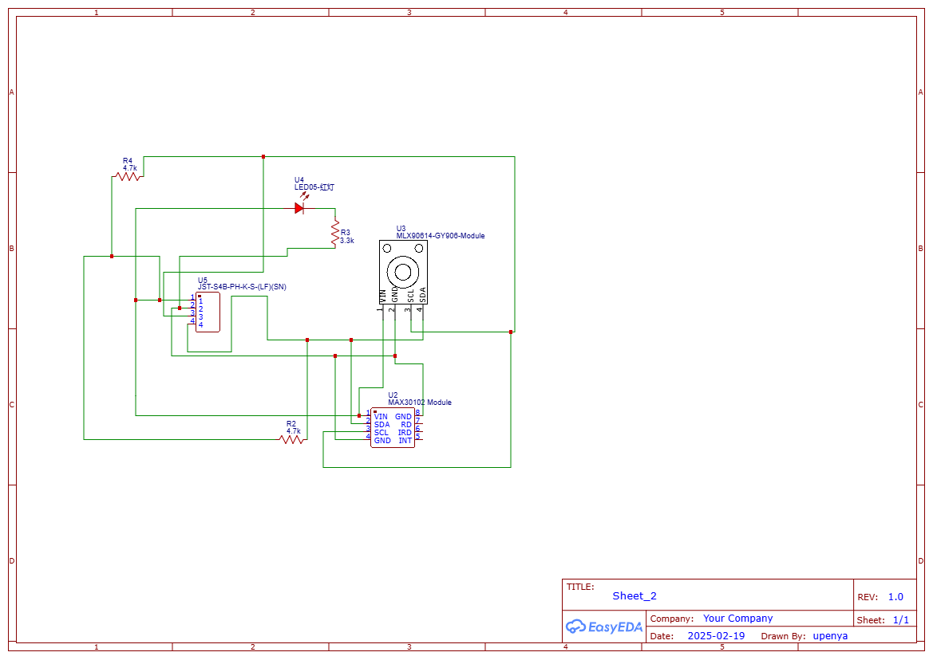
CIRCUIT DIAGRAM
EAR LOBE DEVICE

Slide 14
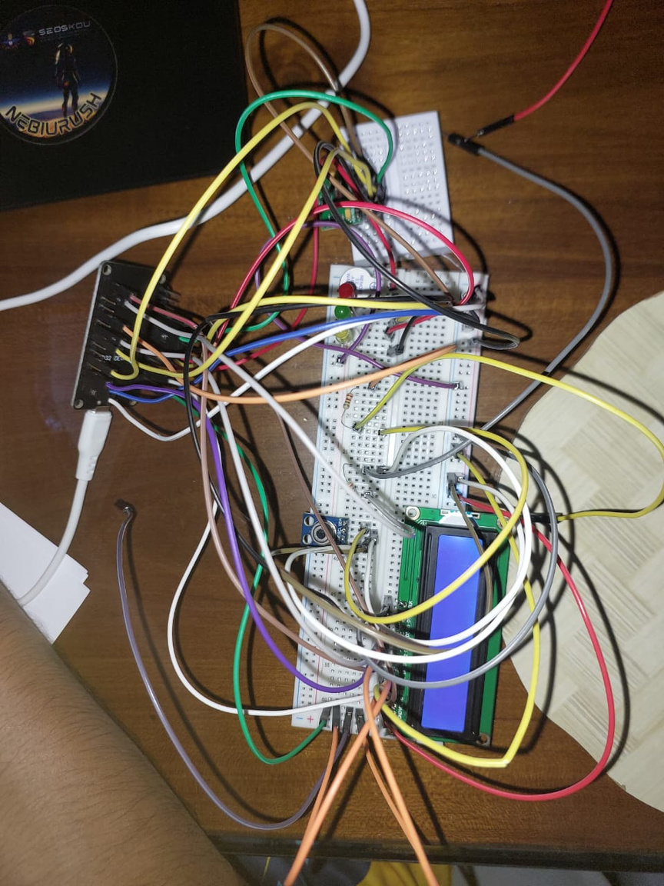
CIRCUIT DIAGRAM

Slide 15

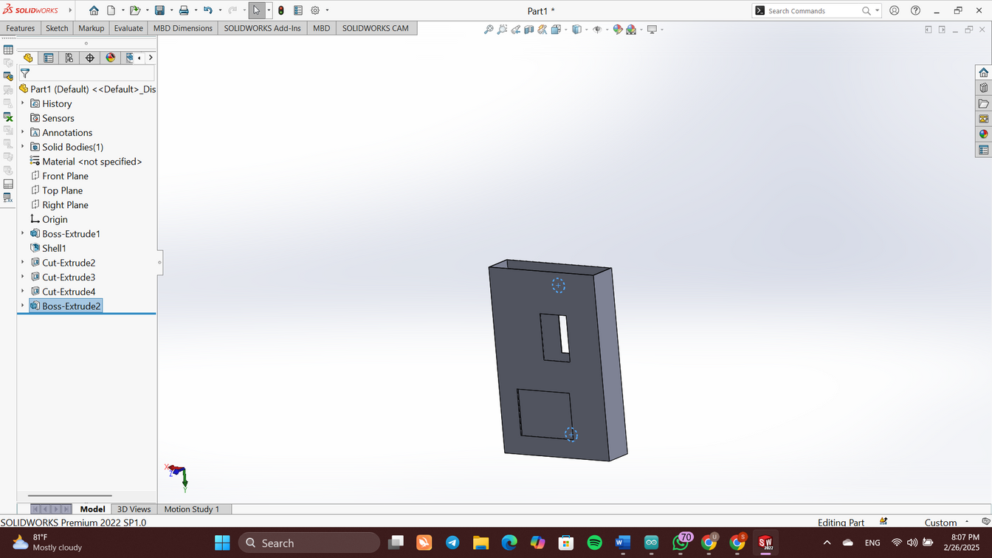
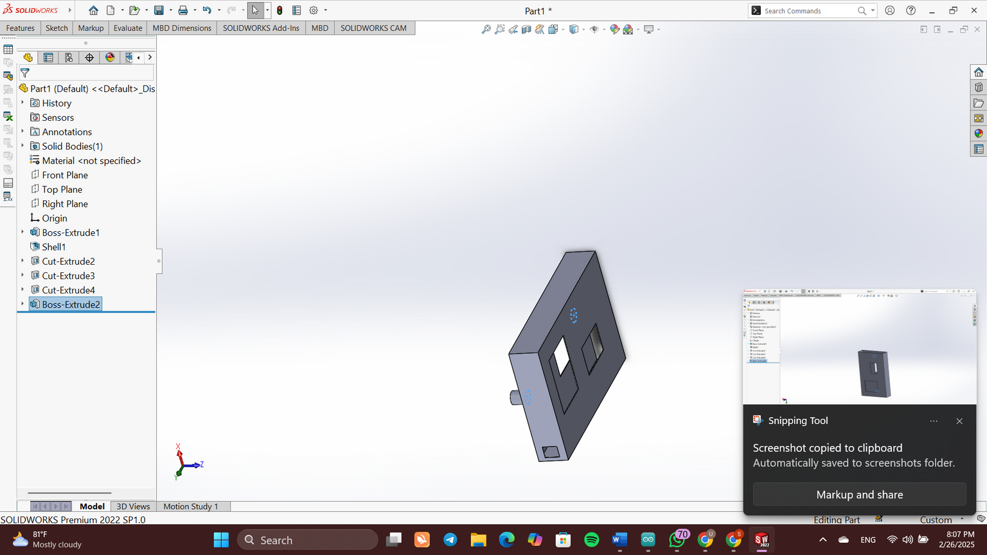
SOLID WORK DESIGN
EAR LOBE DEVICE DESIGN
opening for temperature sensor
opening for MAX30102

Slide 16
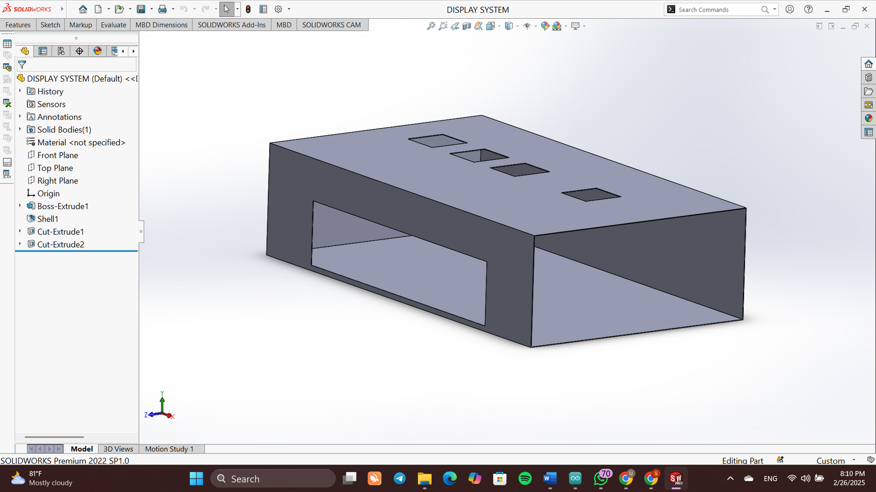

SOLID WORK DESIGN
DISPLAY SYSTEM
OPENINGS FOR LEDS
OPENING FOR LCD DISPLAY

Slide 17
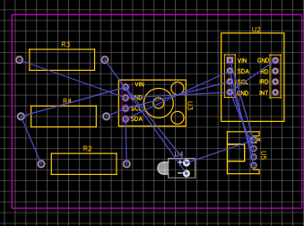
PCB DESIGN
ESP32
MAX30102
MLX90614

Slide 18
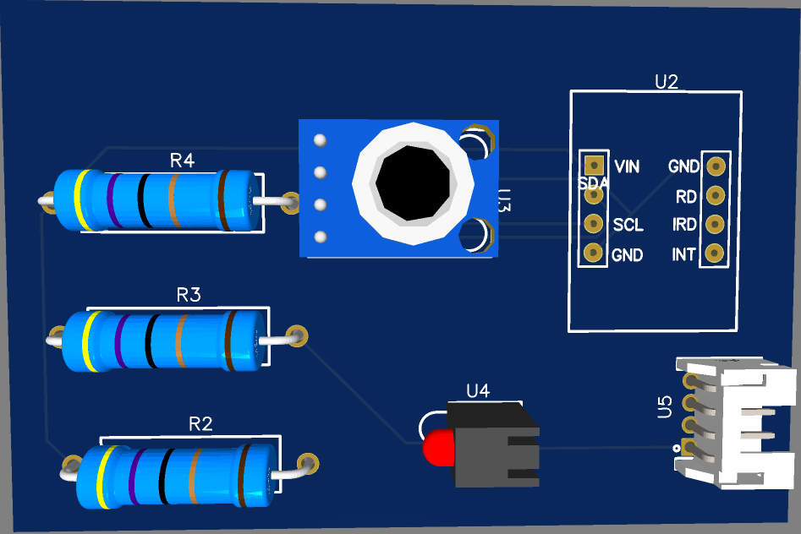
3D View

Slide 19
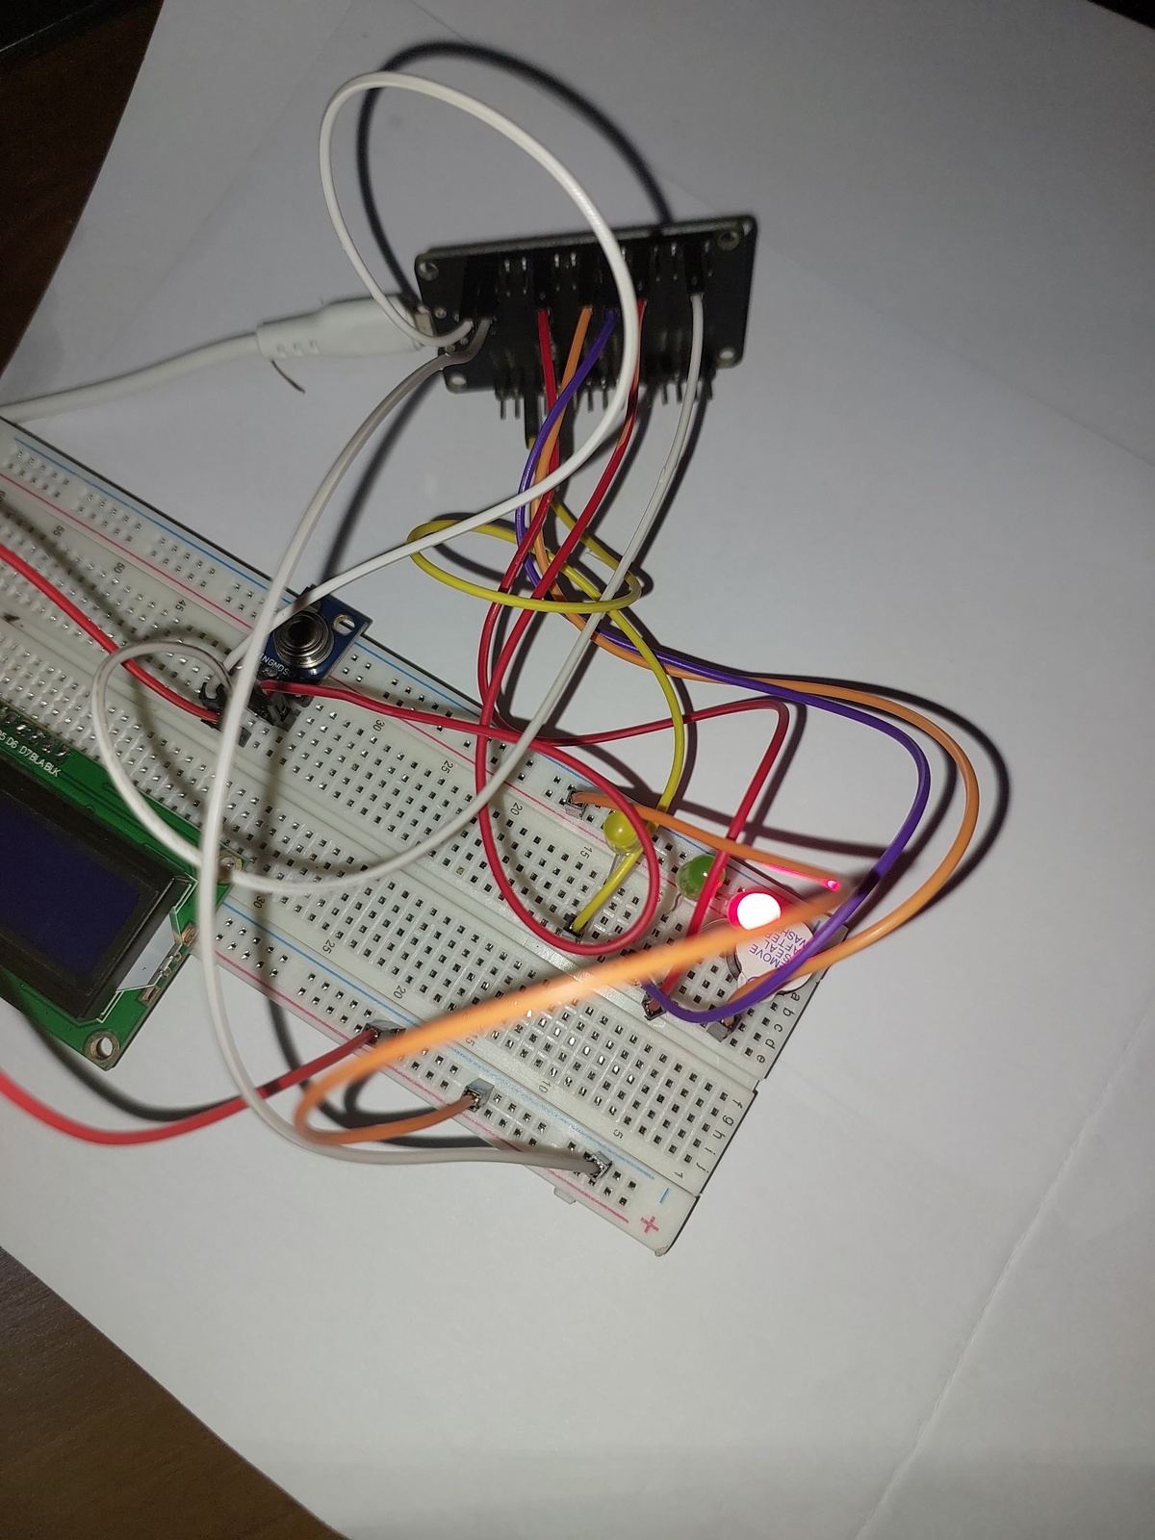
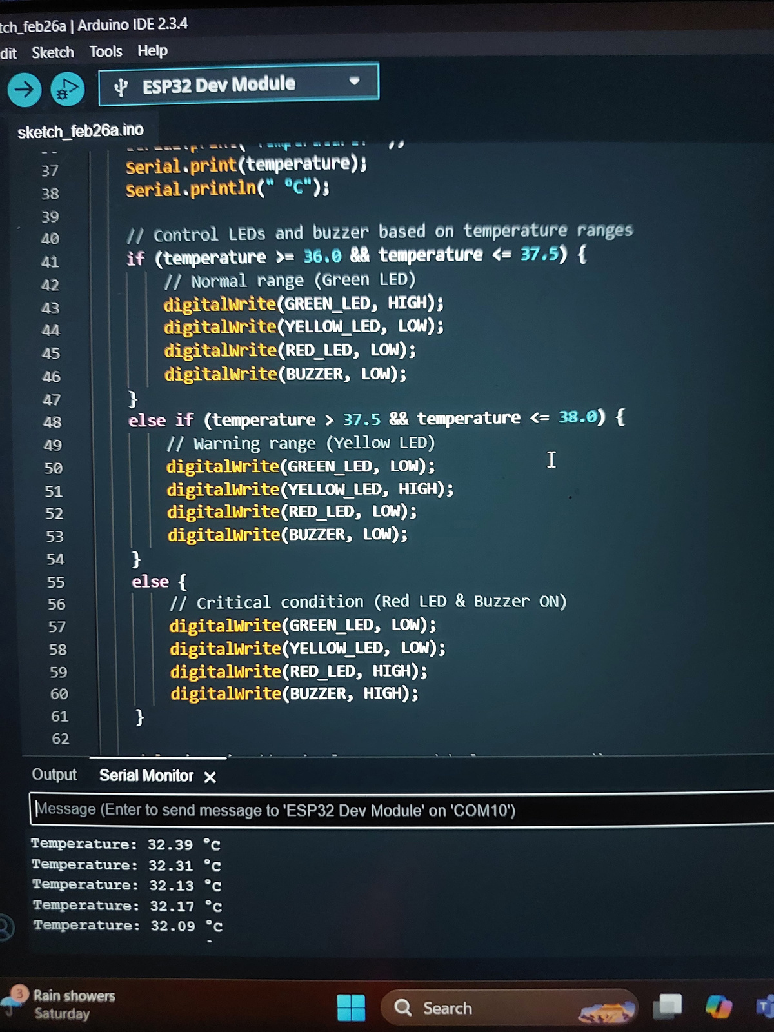
STIMULATION AND RESULTS
Red LED was on and buzzer audible alert when temperature was below 36 celsius
ESP32
MAX30102
MLX90614

Slide 20
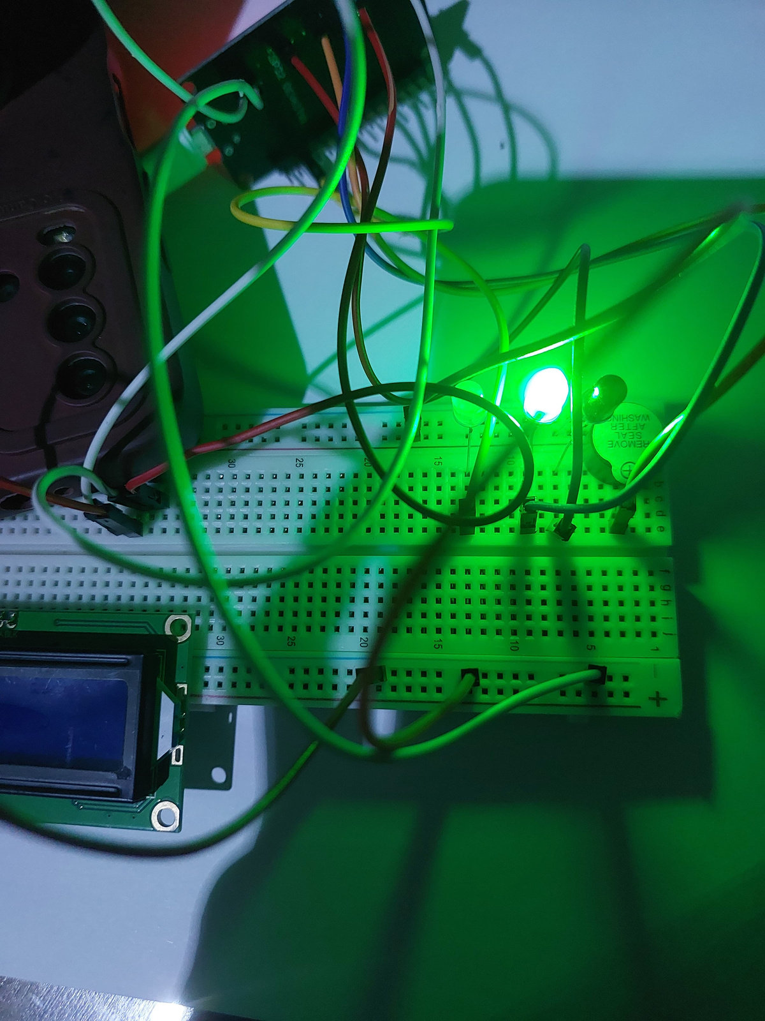
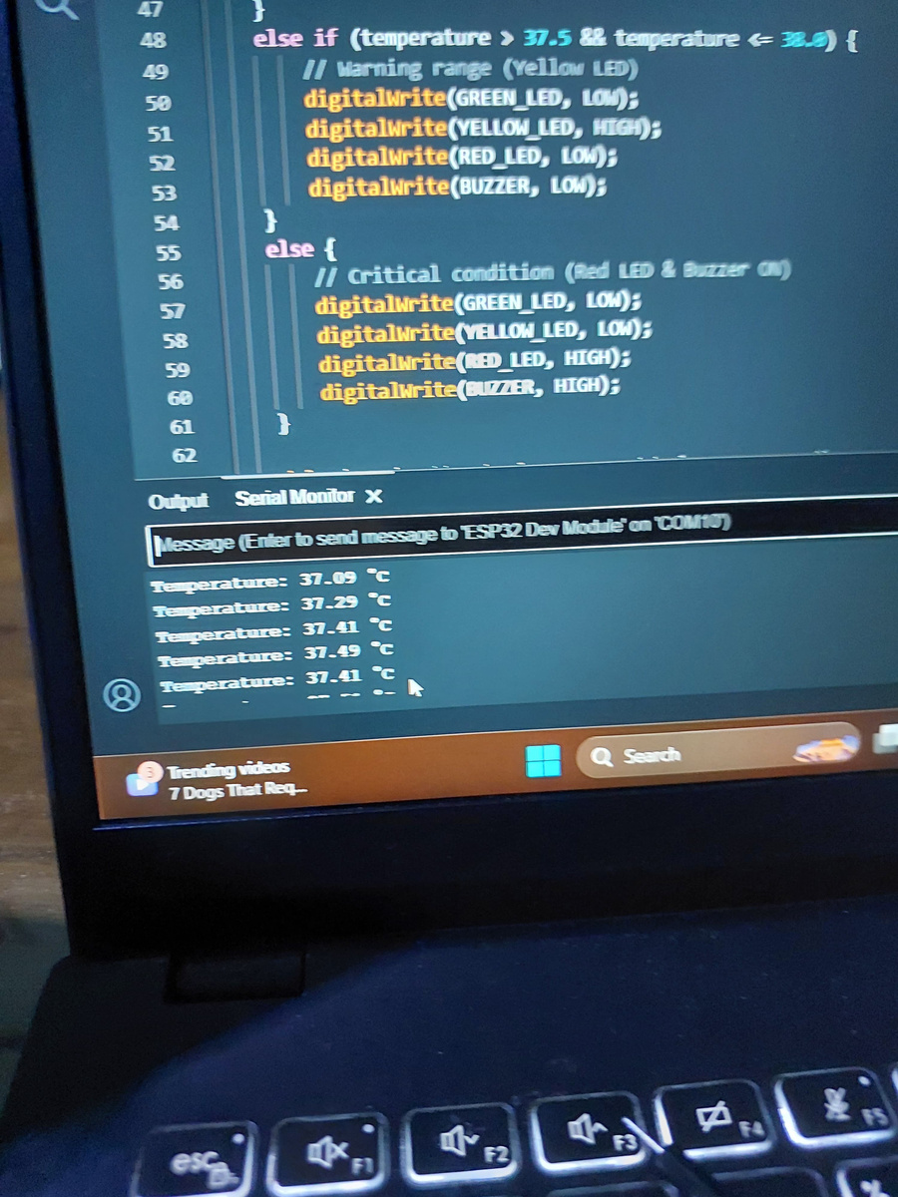
STIMULATION AND RESULTS
Green LED was on when temperature was > 36 celsius and<37.5 celsius
ESP32
MAX30102
MLX90614

Slide 21
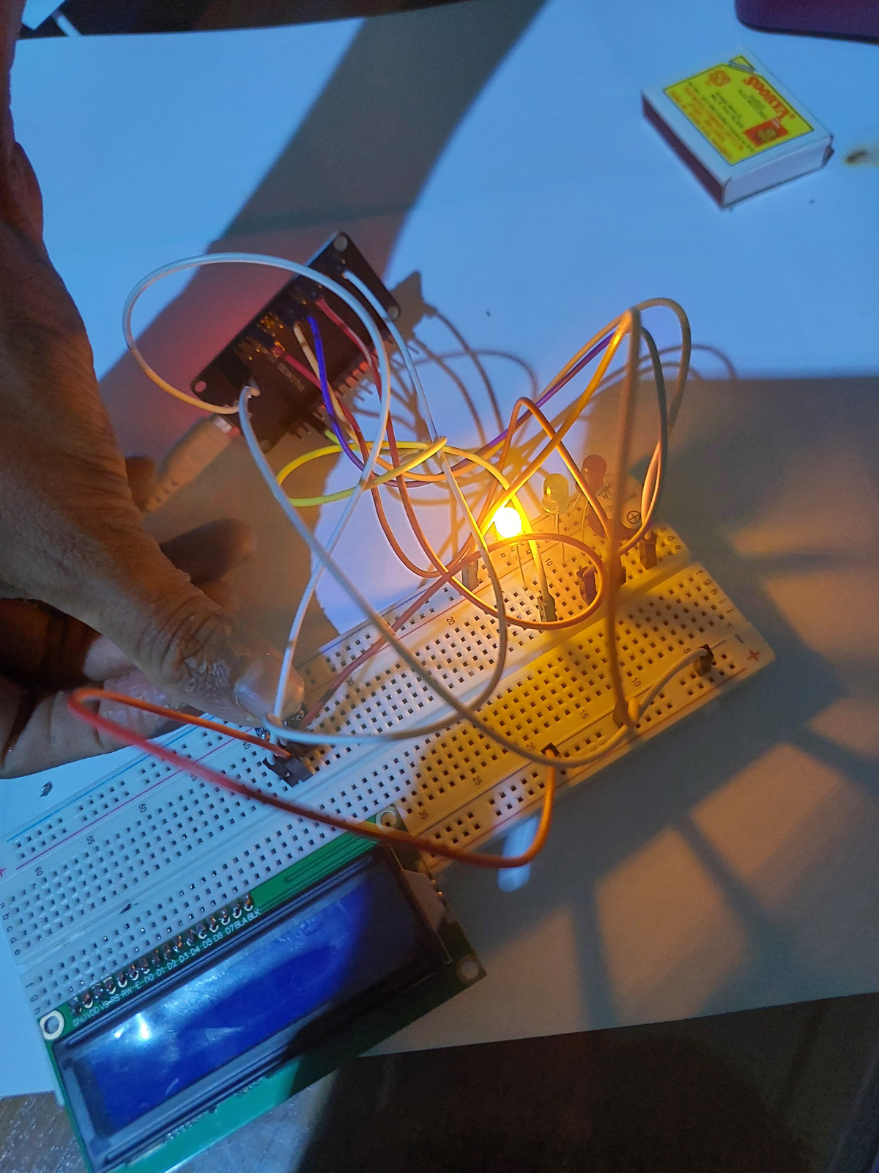
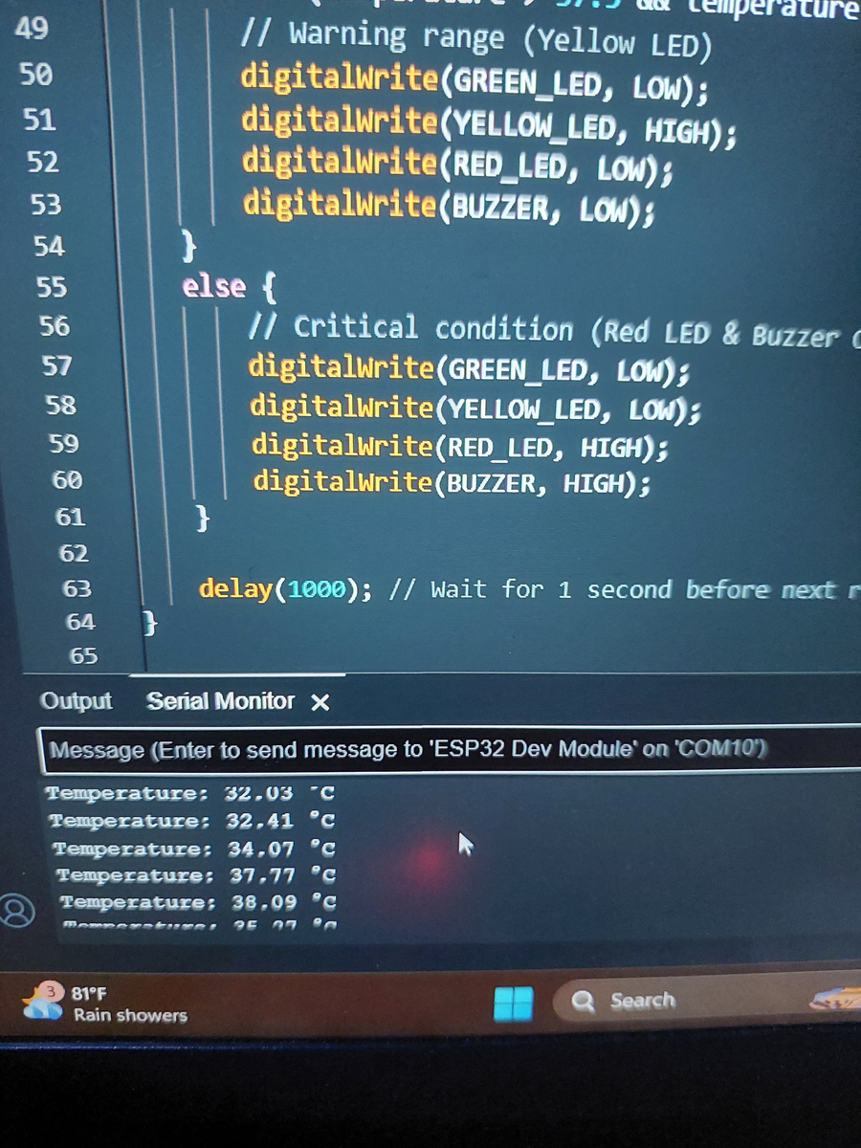
STIMULATION AND RESULTS
YellowLED was onwhen temperature was > 37.5 and <38 celsius
ESP32
MAX30102
MLX90614

Slide 22

PROBLEMS ENCOUNTERED
Library Issues-Despite downloading the required MAX30102 libraries, Arduino IDE showed "No such library" errors.
Code Execution Challenges- After obtaining the code from GitHub, the code executed, but the sensor was not captured.
Sensor Initialization Loop-The sensor repeatedly showed "Initializing" but failed to work.
Circuit Modification Attempts- Made changes to the sensor circuit, but the issue persisted.

Slide 23
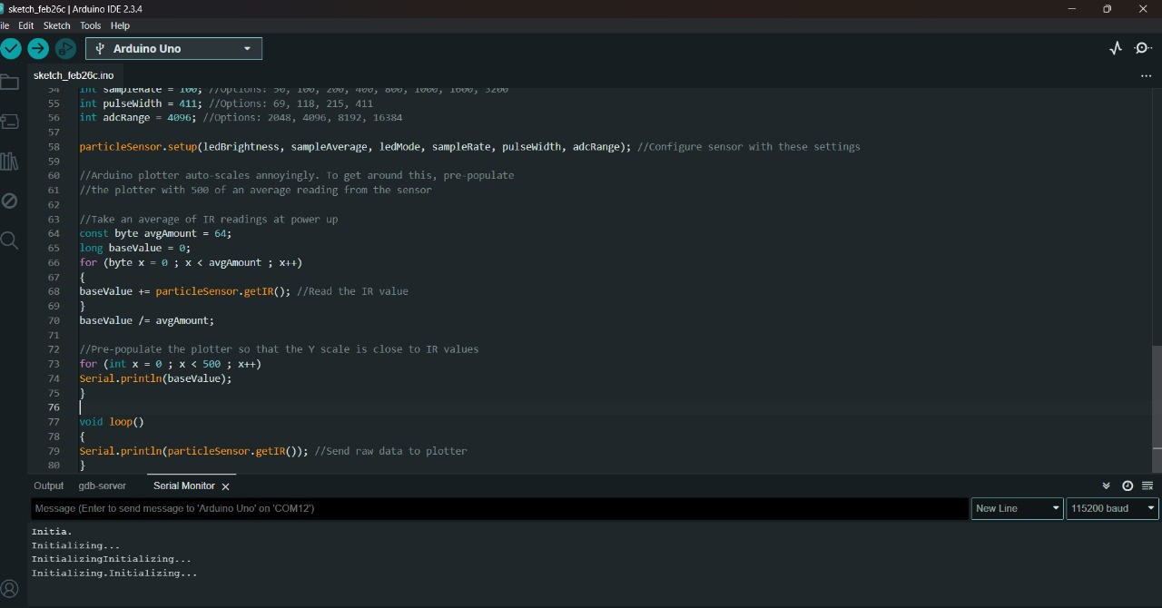
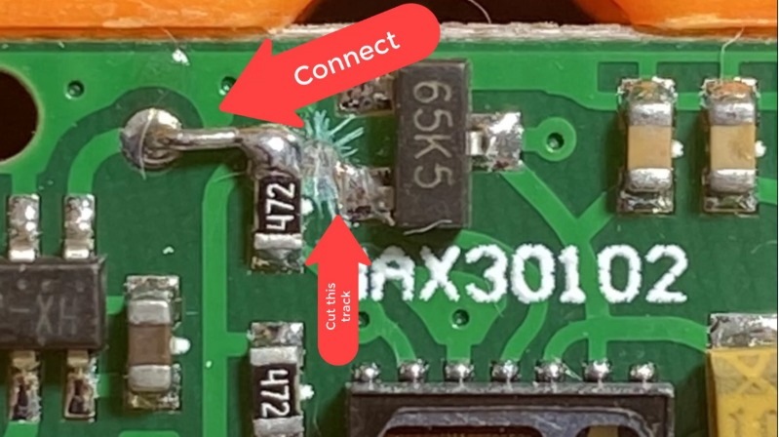

Slide 24
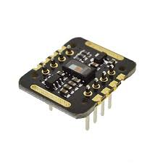

Slide 25
COST ESTIMATION
ESP32 | 1100
MAX30102 Pulse oximeter sensor | 790
LCD Display | 470
Buzzer | 50
3 LED’S | 60
3.7V Li-ion Rechargeable Battery | 1000
resistors | 80
TOTAL COST | 3510

Slide 26
THANK YOU

